Slide 1


Carta and CommonSpirit
SAPS-II and Covid-19 Automation

Slide 2

SAPS-II Registry -- What We’ve Done
Defined a registry schema and form that can generate a SAPS-II score for ICU mortality
Connected the FHIR endpoint data into our registry to automatically populate the SAPS-II fields (resulting in live scores on demand)
Data access at sites by setting up FHIR integration with the EMR--meaning this work can scale across CommonSpirit
Set up analytics for the completed data to show SAPS-II scores over time, average scores for a ward, and potential trigger points for alerts

Slide 3
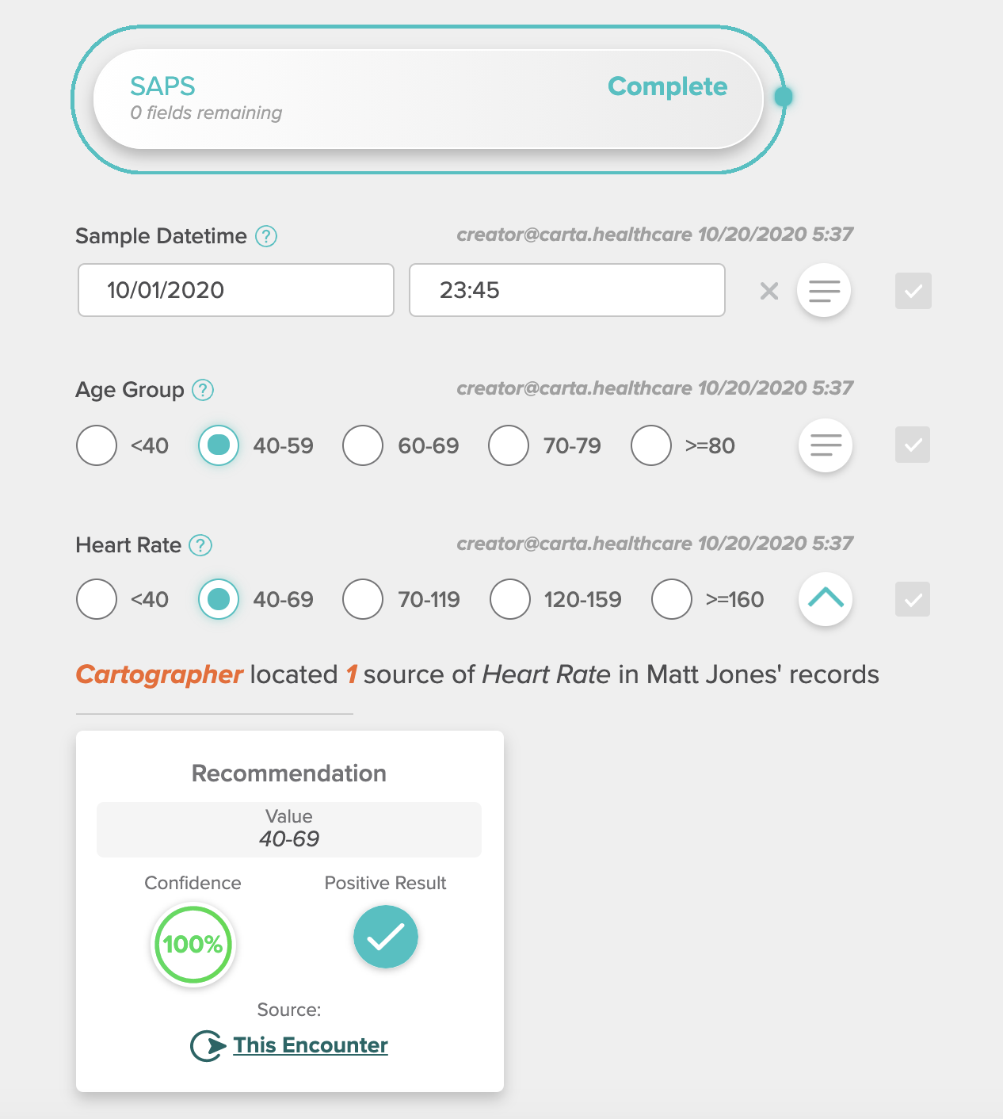
SAPS-II Registry -- Demo
Form schema
Data autofill
Analytics UI

Slide 4
SAPS-II Registry -- Where to go next?
Building a better SAPS-II score
Pull in more data
What data would be most interesting?
Easily accessible?
Clinical notes processed with NLP
AI modeling
Determine most important variables
Improve mortality prediction (a SAPS-III score?)
Academic or white paper?
Deploying to a clinical or operative setting
On-demand scores -- perhaps for ICU discharge prioritization?
Daily report or alerts?
Recommendation for hospice consult?

Slide 5
Covid-19 Registry
What we’ve done
Defined a schema for data collection with relevant covid-19 fields
Set up NLP recommendations to identify proning for patient from the clinical notes
Established ‘cross-pollination’ between the SAPS-II registry and this one, where answers in one registry autofill to the next
Enabled a ‘google search’ of the patient’s notes
Where to go next?
Set up automation via FHIR (or enable Carta abstractors) for this registry
Iterate on the data definitions to add in fields of interest
Set up analytics to help study and address covid-19 care

Slide 6
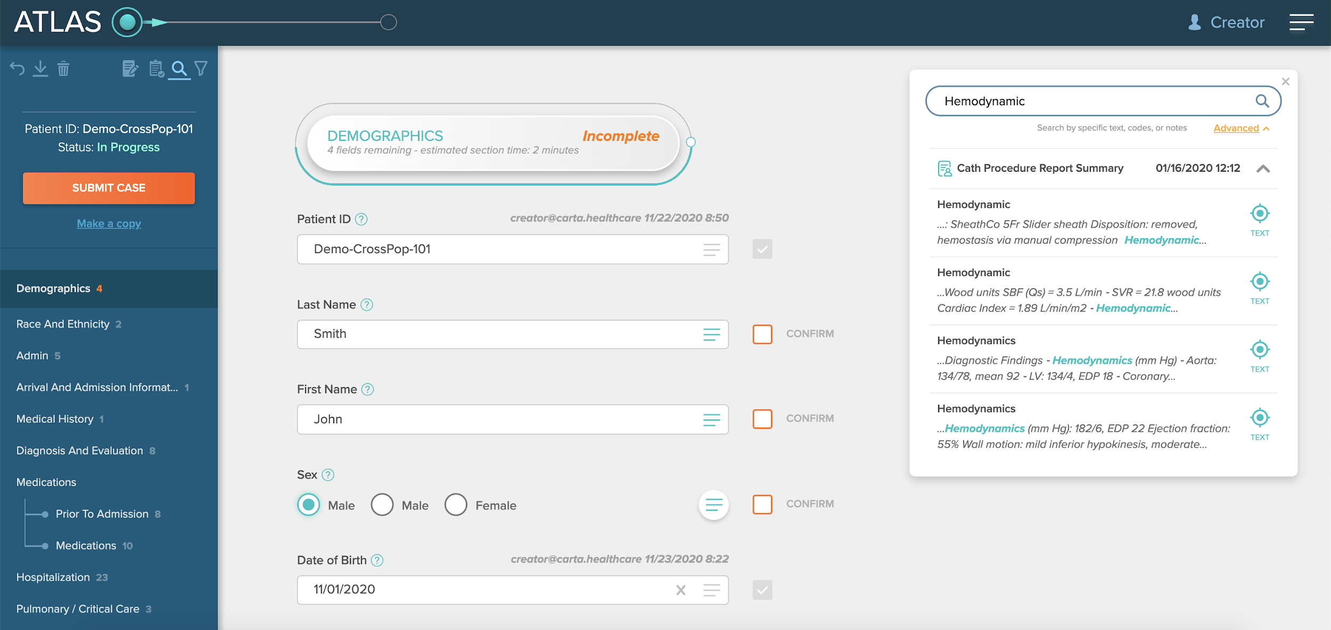
Demo of Covid Registry

Slide 7
Automated FHIR Resources
Live Atlas Capabilities
Carta is able to pull data directly from the EMR’s FHIR endpoint to provide recommendations for fields in our forms. This allows us to develop and iterate on registries quickly and easily. By organizing the data in our knowledge-graph based on a given patient encounter, we can deliver high-quality machine-readable data on demand.
NLP Concept Extraction
Carta is able to read clinical notes, extracting UMLS concepts from text. This allows for a ‘google search’ of the patient’s records, making previously hard to unlock data available for analytics. This capability can help to unify clinical and operational data to improve care.
Machine-Readable Data for Analytics
Carta’s data can be exported into JSON, excel, Tableau, or into your data warehouse. This helps avoid siloed data and allows us to run the same set of analytics across different hospitals. In addition to helping extract and clean the data, Carta can also help use the data to improve care and operations.

Slide 8

Thank You!
support@carta.healthcare
www.carta.healthcare
M-000036_FOP_SD_Template_2020_10_22

